Slide 1


INDIAN BOARDING HOMES
Class Action
CATEGORY 1
Claim Form Guide

Slide 2


ELIGIBILITY
Students who were placed in private homes between September 1, 1951, and June 30, 1992, to attend primary or secondary school.
To be eligible the class member must have been alive on or after July 24, 2016
(not post-secondary)
INDIAN BOARDING HOMES Class Action

Slide 3

SUBMISSION DEADLINE
February 22, 2027
INDIAN BOARDING HOMES Class Action

Slide 4

MENTAL HEALTH
SUPPORT
Hope for Wellness
Open 24 hours a day - 7 days a week
1-855-242-3310
www.hopeforwellness.ca
INDIAN BOARDING HOMES Class Action

Slide 5

CLAIM FORM
SUPPORT
Claims Administrator
Monday – Friday | 9 AM to 7 PM EST
1-888-499-1144
claims@boardinghomesclassaction.com
www.boardinghomesclassaction.com
INDIAN BOARDING HOMES Class Action

Slide 6

LEGAL SUPPORT
You can contact a lawyer to help you with your claim forms.
CONTACT YOUR LOCAL BAR ASSOCIATION
www.boardinghomesclass
action.com/resources
CLAIM FORM 1
The Claims Administrator will not pay the cost of the lawyer.
CLAIM FORM 2
The Claims Administrator will pay the cost of the lawyer.
INDIAN BOARDING HOMES Class Action

Slide 7


THERE ARE TWO CATEGORIES OF CLAIM FORMS
INDIAN BOARDING HOMES Class Action

Slide 8
CATEGORY 1
CLAIM FORM
COMMON EXPERIENCE COMPENSATION
For placement in the
Indian Boarding Homes Program
$10,000
INDIAN BOARDING HOMES Class Action

Slide 9
CATEGORY 2
CLAIM FORM
ADDITIONAL COMPENSATION
FOR HARMS SUFFERED
Depending on the harm,
compensation will range.
$10,000 to $200,000
INDIAN BOARDING HOMES Class Action

Slide 10
CATEGORY
FORM
DETAILS
CATEGORY 1
CATEGORY 2
Category 1 claim form
must be completed first.
This form is not required.
The Claims Administrator will cover the cost of a lawyer for Category 2.
INDIAN BOARDING HOMES Class Action

Slide 11



HOW TO APPLY
FOR COMPENSATION
There are three ways to obtain a
claim form.
ONLINE
CLAIM FORM
DOWNLOAD
CLAIM FORM
MAIL REQUEST
FOR CLAIM FORM
INDIAN BOARDING HOMES Class Action

Slide 12



TIPS
Take Your Time
?
Frequently Asked Questions
Contact the Claims Administrator for Support
INDIAN BOARDING HOMES Class Action

Slide 13
FORM TYPES
CATEGORY 1
INDIAN BOARDING HOMES Class Action

Slide 14



FORM TYPES
CATEGORY 1
IBHP – Form A1
Indian Boarding Homes Class Action
Category 1 - Compensation for Placement in the Indian Boarding Homes Program Claim Form (Individual)
Canada created the Indian Boarding Homes Program in the 1950s which removed First Nations and Inuit children from their communities and placed them in private homes for the purpose of attending school.
The Indian Boarding Homes Class Action provides compensation to people placed in these
homes. Primary Class Members of the Indian Boarding Homes Class Action are eligible claimants.
Primary Class Members are individuals who were placed in private homes, during the period of
September 1, 1951 and June 30, 1992, for the purpose of attending school, not including
placements for post-secondary education. Individuals placed after June 30, 1992, are also included if
Canada was responsible for their placement.
For Primary Class Members who died on or after July 24, 2016, this is the wrong form. The person in
charge of their estate can complete the Estates Forms on their behalf. If the Primary Class Member is
alive and you are the Personal Representative appointed to manage their affairs, this is the wrong
form. Please complete the Personal Representative Forms.
INDIVIDUAL CLAIM FORM (A1)
Eligible claimants may apply for two categories of compensation:
CLAIM FORM A1
Filling out the form for yourself.
1. Category 1 - Compensation Claim for Placement in the Indian Boarding Home Program
2. Category 2 - Compensation Claim for Abuse
This is an application form for a Category 1 payment. Your first step is to complete this form.
You can file a Category 2 Claim for Abuse later OR at the same time as this form.
To learn more about eligibility, relevant dates, and the class action itself, visit:
https://boardinghomesclassaction.com/
IMPORTANT: The claim application process has a deadline. Claims Deadline: February 22, 2027
INDIAN BOARDING HOMES Class Action

Slide 15
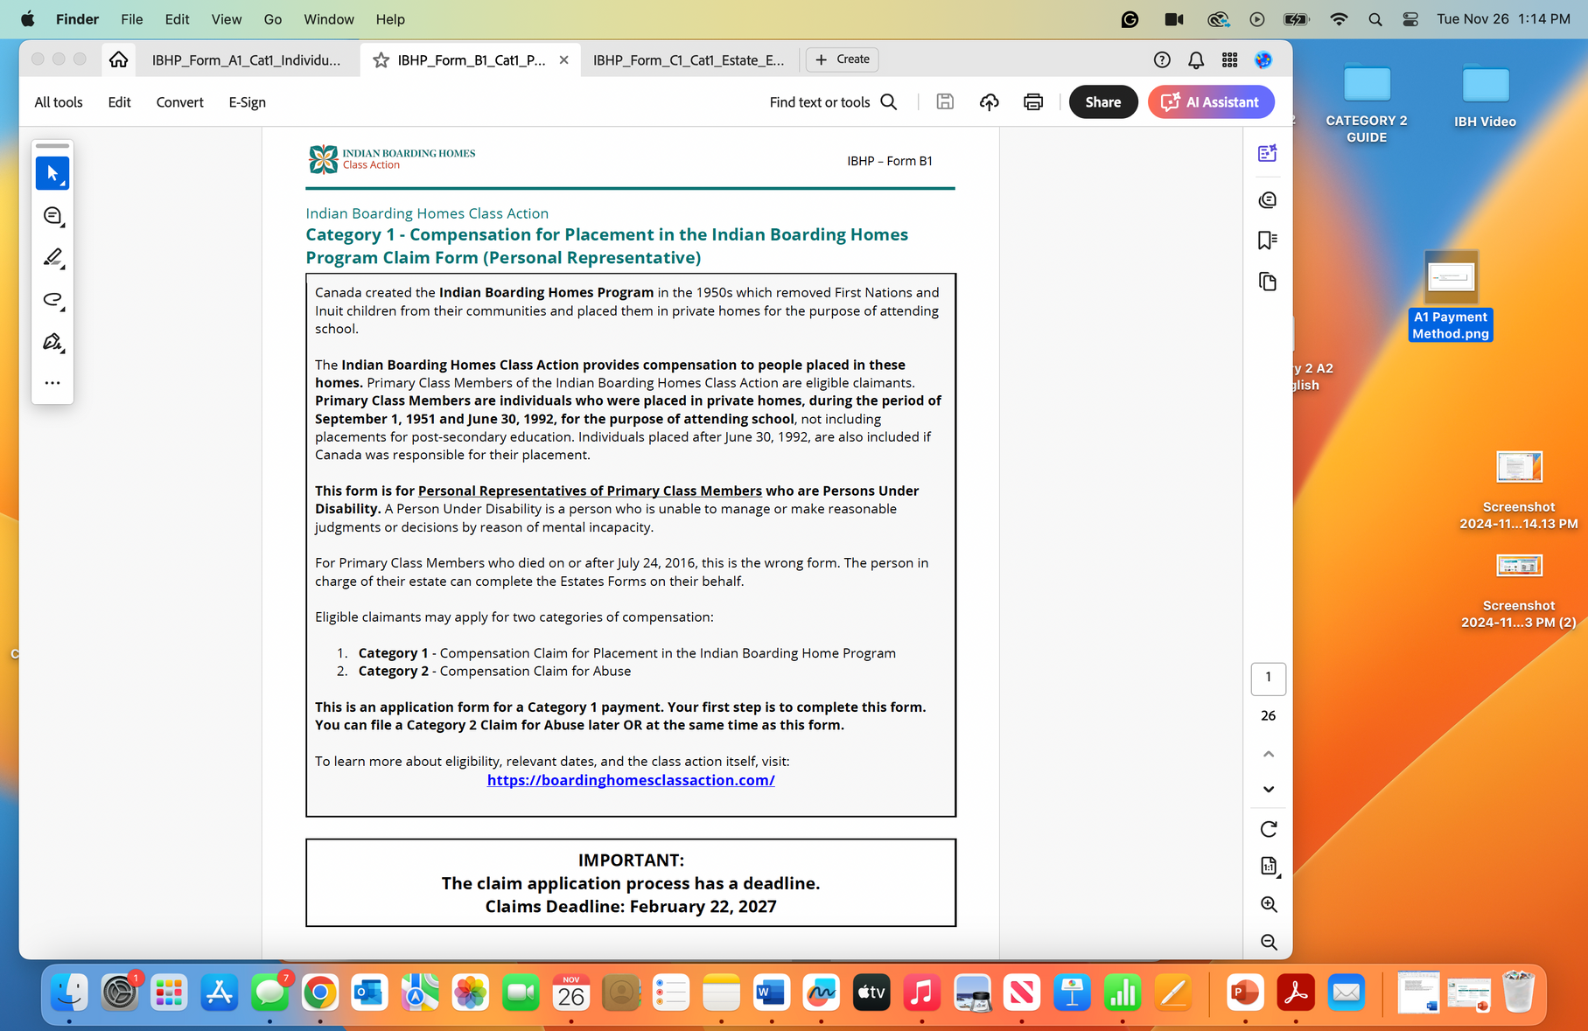
FORM TYPES
CATEGORY 1
PERSONAL REPRESENTATIVE FORM (B1)
CLAIM FORM B1
Filling out the form for someone without the mental capacity to do it themselves.
INDIAN BOARDING HOMES Class Action

Slide 16

FORM TYPES
CATEGORY 1
ESTATE FORM (C1)
CLAIM FORM C1
Filling out the form for someone who has passed away.
INDIAN BOARDING HOMES Class Action

Slide 17
CATEGORY 1
SECTION A | CLAIMANT INFORMATION
INDIAN BOARDING HOMES Class Action

Slide 18

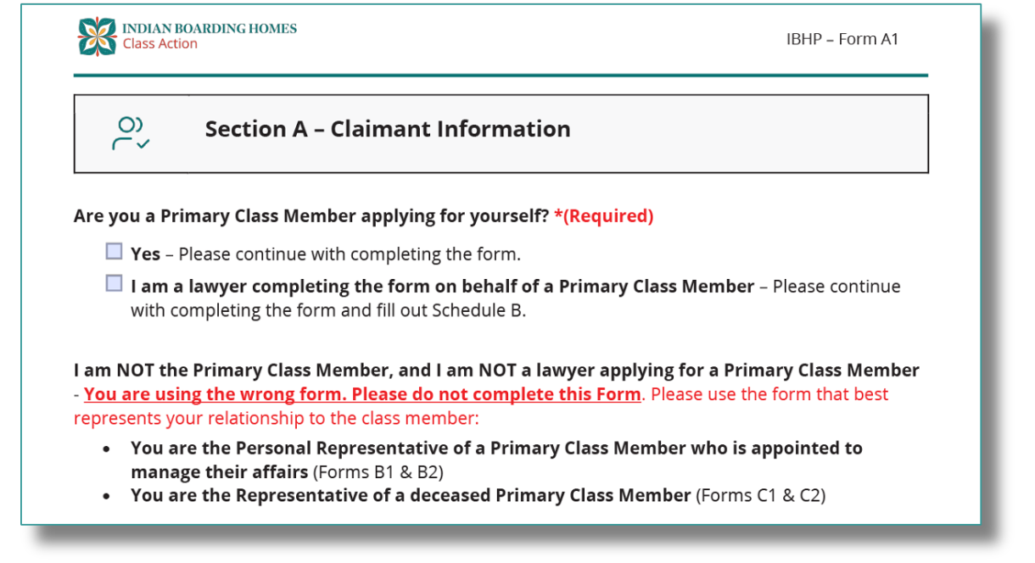

CATEGORY 1
SECTION A
PAGE 5
OF CLAIM FORM
INDIAN BOARDING HOMES Class Action

Slide 19
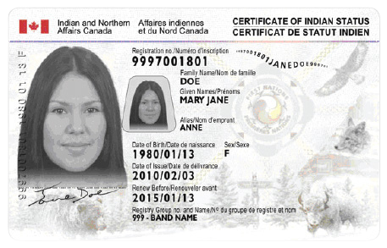

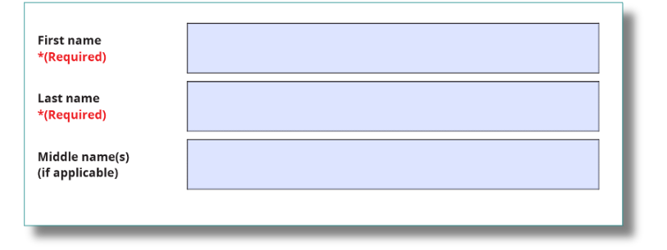
CATEGORY 1
SECTION A
PAGE 5
OF CLAIM FORM
Mary Jane
Doe
INDIAN BOARDING HOMES Class Action

Slide 20
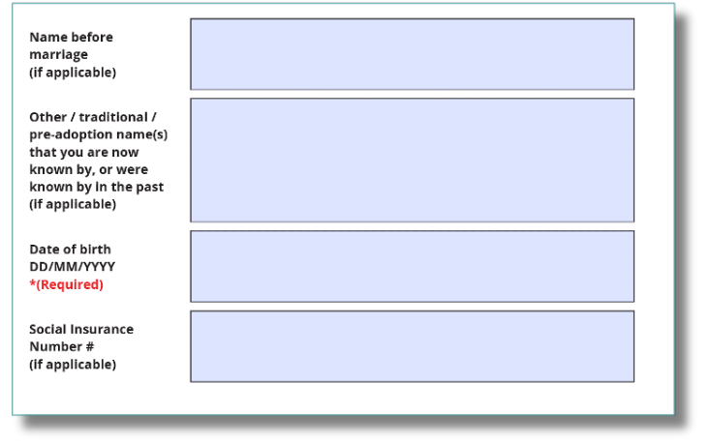
CATEGORY 1
SECTION A
PAGE 6
OF CLAIM FORM
INDIAN BOARDING HOMES Class Action

Slide 21
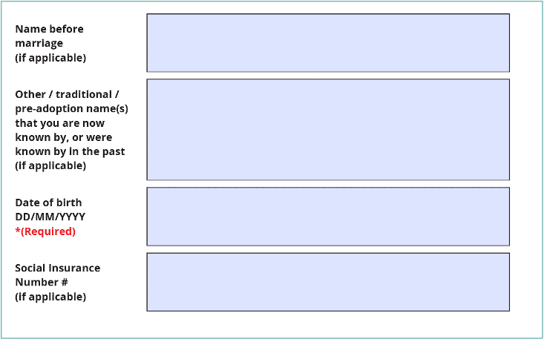
CATEGORY 1
SECTION A
PAGE 6
OF CLAIM FORM
INDIAN BOARDING HOMES Class Action

Slide 22
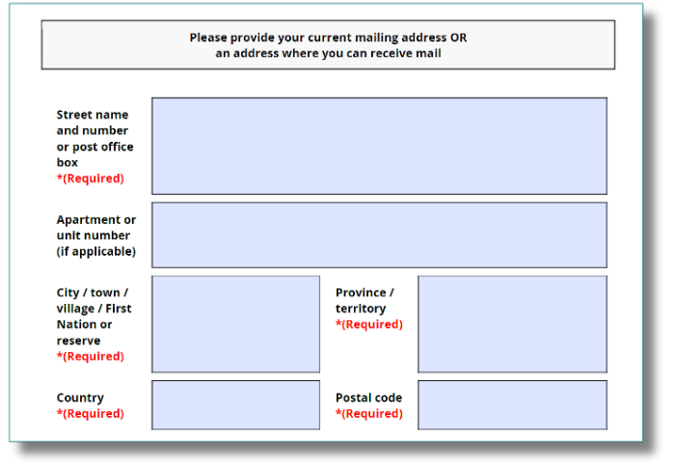
CATEGORY 1
SECTION A
PAGE 7
OF CLAIM FORM
INDIAN BOARDING HOMES Class Action

Slide 23
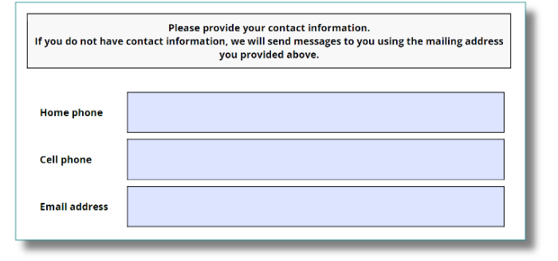
CATEGORY 1
SECTION A
PAGE 8
OF CLAIM FORM
INDIAN BOARDING HOMES Class Action

Slide 24
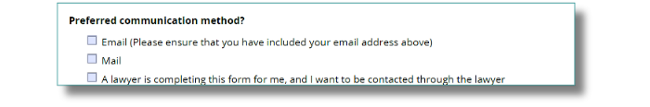
CATEGORY 1
SECTION A
PAGE 8
OF CLAIM FORM
INDIAN BOARDING HOMES Class Action

Slide 25
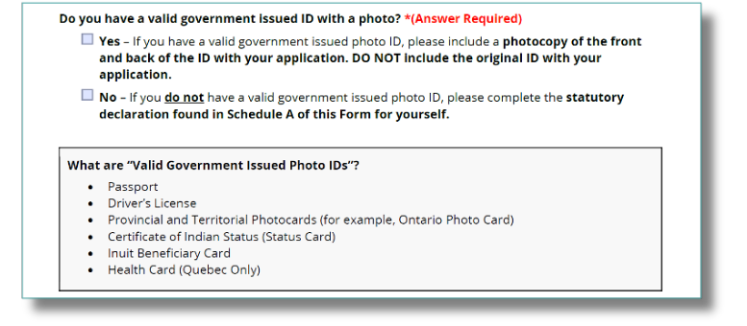
CATEGORY 1
SECTION A
PAGE 8
OF CLAIM FORM
INDIAN BOARDING HOMES Class Action

Slide 26
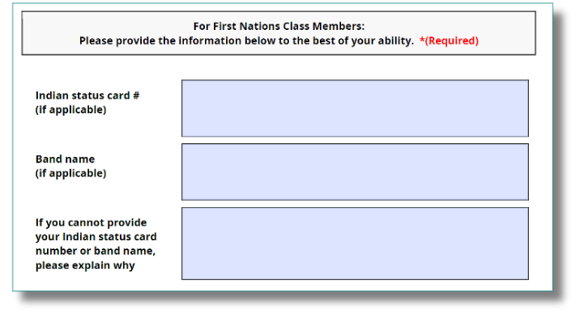
CATEGORY 1
SECTION A
PAGE 9
OF CLAIM FORM
#1
#1
#2
#2
INDIAN BOARDING HOMES Class Action

Slide 27
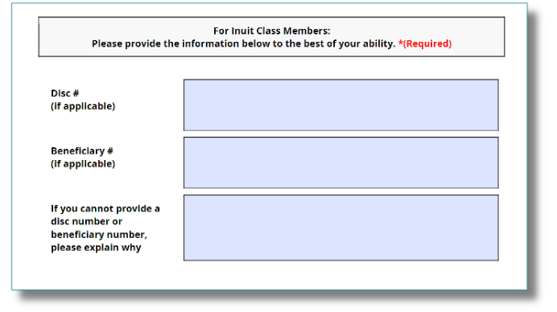
CATEGORY 1
SECTION A
PAGE 9
OF CLAIM FORM
INDIAN BOARDING HOMES Class Action

Slide 28
CATEGORY 1
SECTION B | PAYMENT INFORMATION
INDIAN BOARDING HOMES Class Action

Slide 29
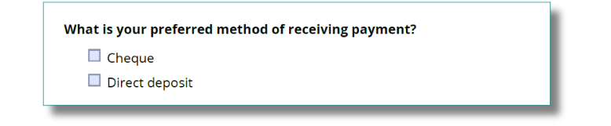
CATEGORY 1
SECTION B
PAGE 10
OF CLAIM FORM
INDIAN BOARDING HOMES Class Action

Slide 30
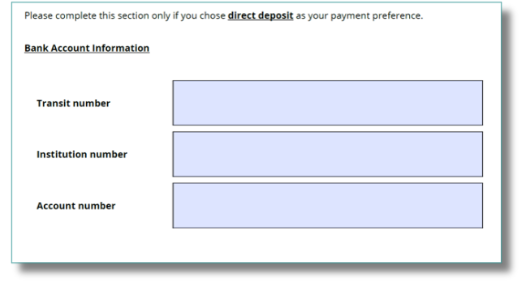
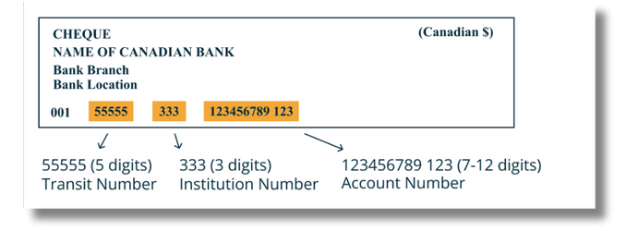
CATEGORY 1
SECTION B
PAGE 10
OF CLAIM FORM
INDIAN BOARDING HOMES Class Action

Slide 31
CATEGORY 1
SECTION C | TIME IN THE
BOARDING HOME PROGRAM
INDIAN BOARDING HOMES Class Action

Slide 32
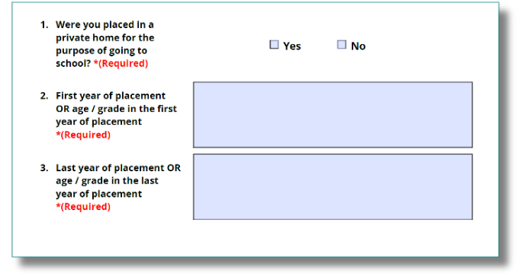
CATEGORY 1
SECTION C
PAGE 12
OF CLAIM FORM
INDIAN BOARDING HOMES Class Action

Slide 33
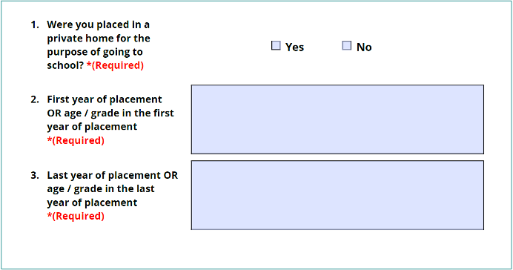
CATEGORY 1
SECTION C
PAGE 12
OF CLAIM FORM
INDIAN BOARDING HOMES Class Action

Slide 34
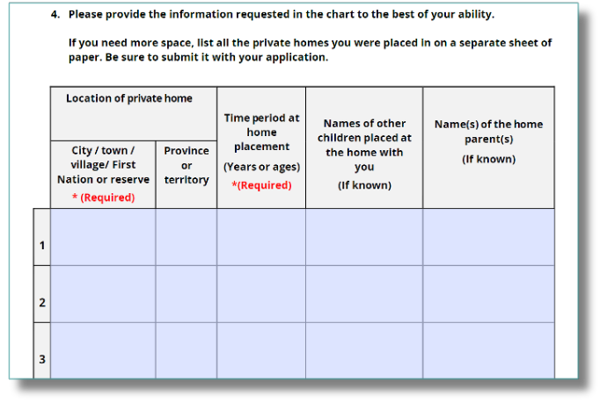
CATEGORY 1
SECTION C
PAGE 13
OF CLAIM FORM
(If more than 1 boarding home)
INDIAN BOARDING HOMES Class Action

Slide 35
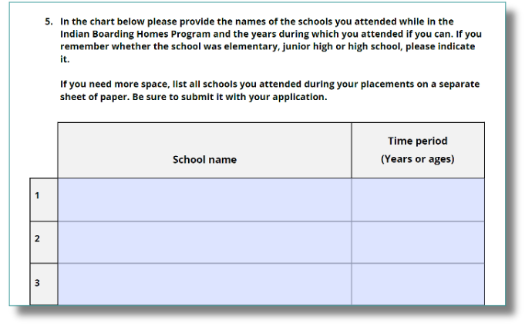
CATEGORY 1
SECTION C
PAGE 14
OF CLAIM FORM
(If more than 1 school)
INDIAN BOARDING HOMES Class Action

Slide 36
CATEGORY 1
SECTION D | OUTREACH INFORMATION
INDIAN BOARDING HOMES Class Action

Slide 37
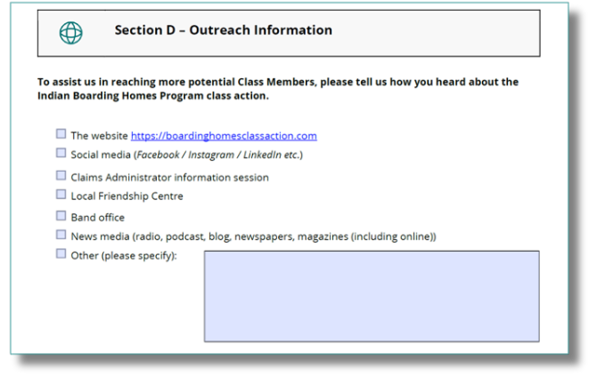
CATEGORY 1
SECTION D
PAGE 15
OF CLAIM FORM
INDIAN BOARDING HOMES Class Action

Slide 38
CATEGORY 1
SECTION E | AGREEMENT
INDIAN BOARDING HOMES Class Action

Slide 39
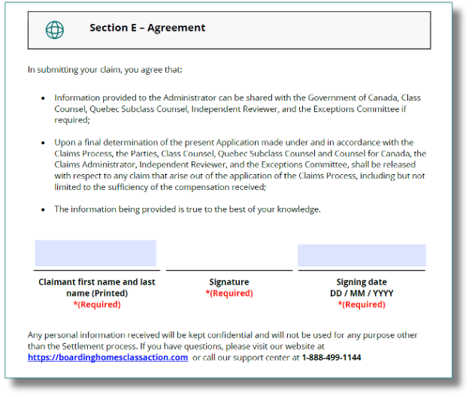
CATEGORY 1
SECTION E
PAGE 16
OF CLAIM FORM
INDIAN BOARDING HOMES Class Action

Slide 40

SUBMIT CLAIM
If you provided your ID and did not use a lawyer, you can submit your claim.
INDIAN BOARDING HOMES Class Action

Slide 41

Online
www.boardinghomesclassaction.
com/claim-forms
SUBMIT CLAIM
Email
claims@boardinghomesclassaction.com
You can submit your claim form four different ways.
Fax
Subject: Indian Boarding Homes Class Action
Fax Number: 1-833-912-5047
Mail
Attn: Indian Boarding Homes Class Action
18 York Street, Suite 2500, Toronto, Ontario, Canada, M5J 0B2
INDIAN BOARDING HOMES Class Action

Slide 42
INDIAN BOARDING HOMES
Class Action
THANK YOU
FOR COMING

